Slide 1
Using Galaxy Shapes to Develop a De-biasing Framework for Deep Learning
Christopher J Miller
(UM Astronomy, Physics)
Esteban Medina-Rosales, Guillermo Cabrera-Vivas
(Universidad de Concepcion, Computer Science)

Slide 2
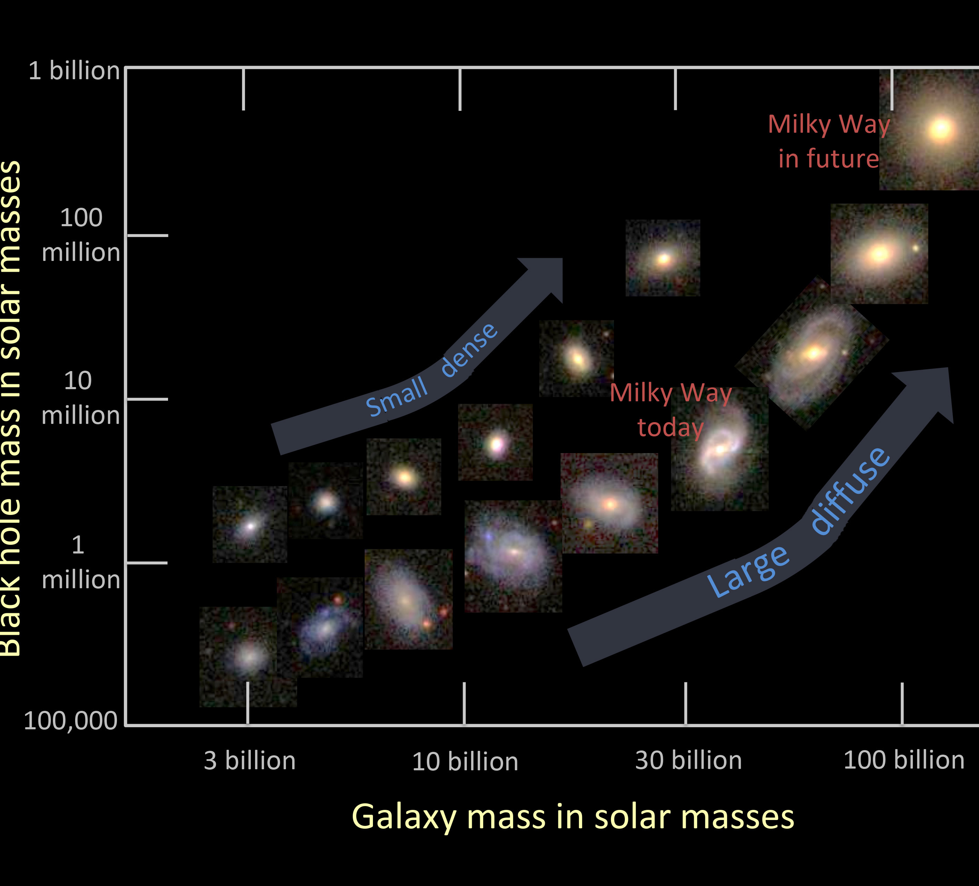
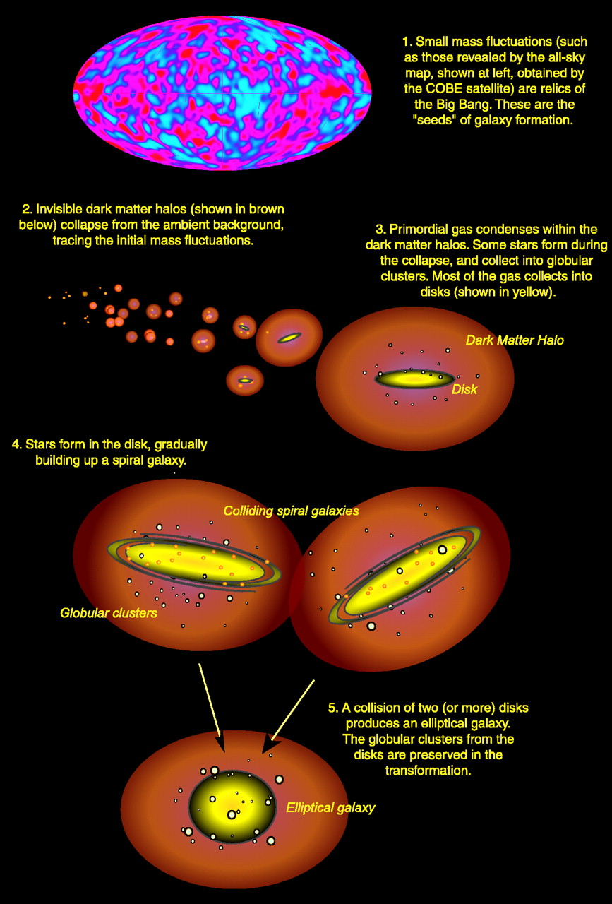

Slide 3
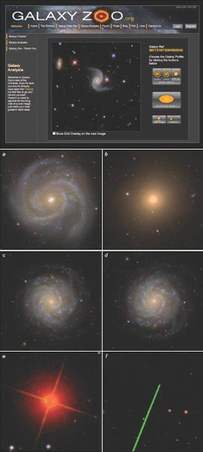

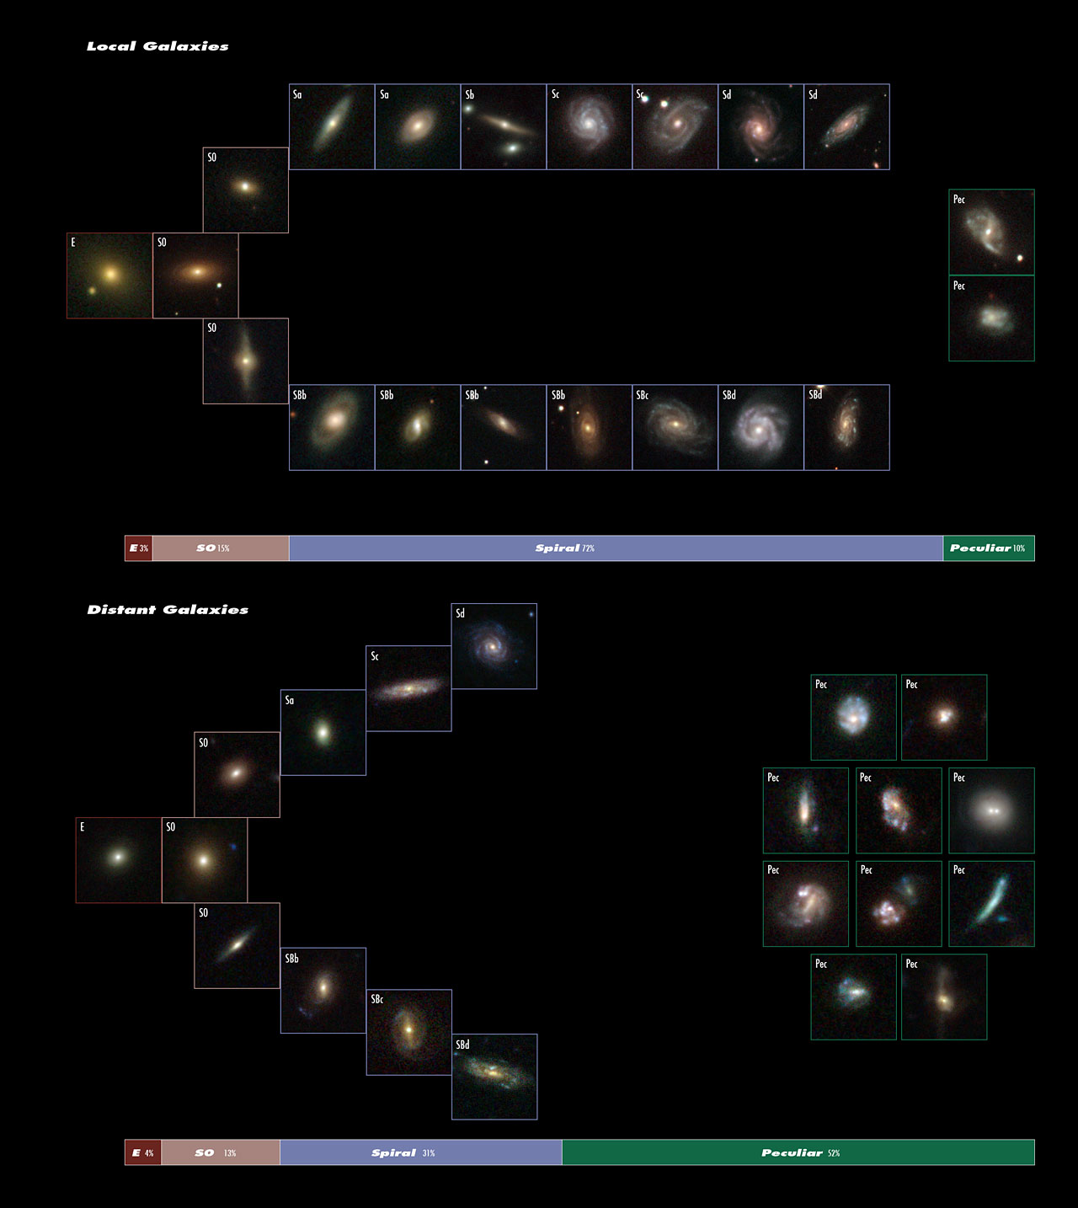
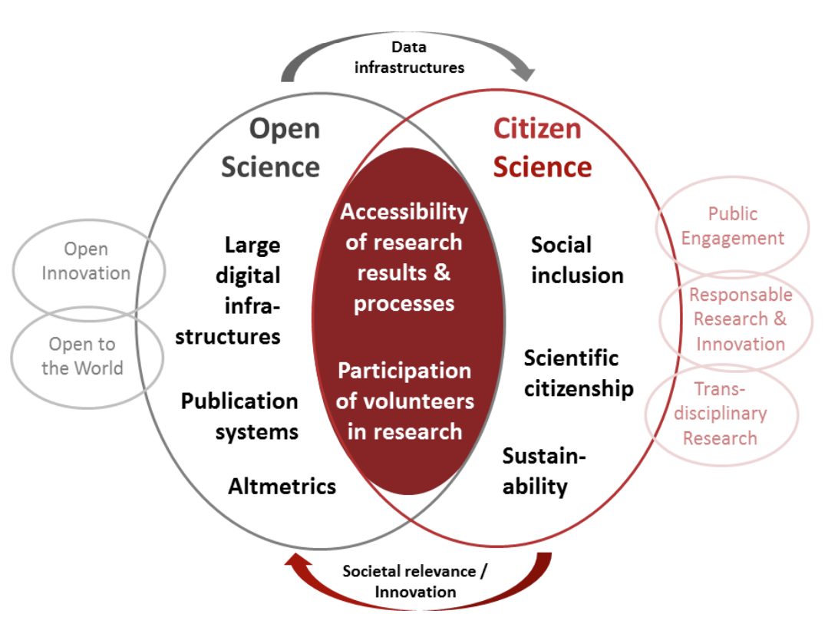
The Hubble “Tuning Fork” Diagram
Nearby
ASTRONOMY DRIVES CITIZEN SCIENCE
Distant

Slide 4
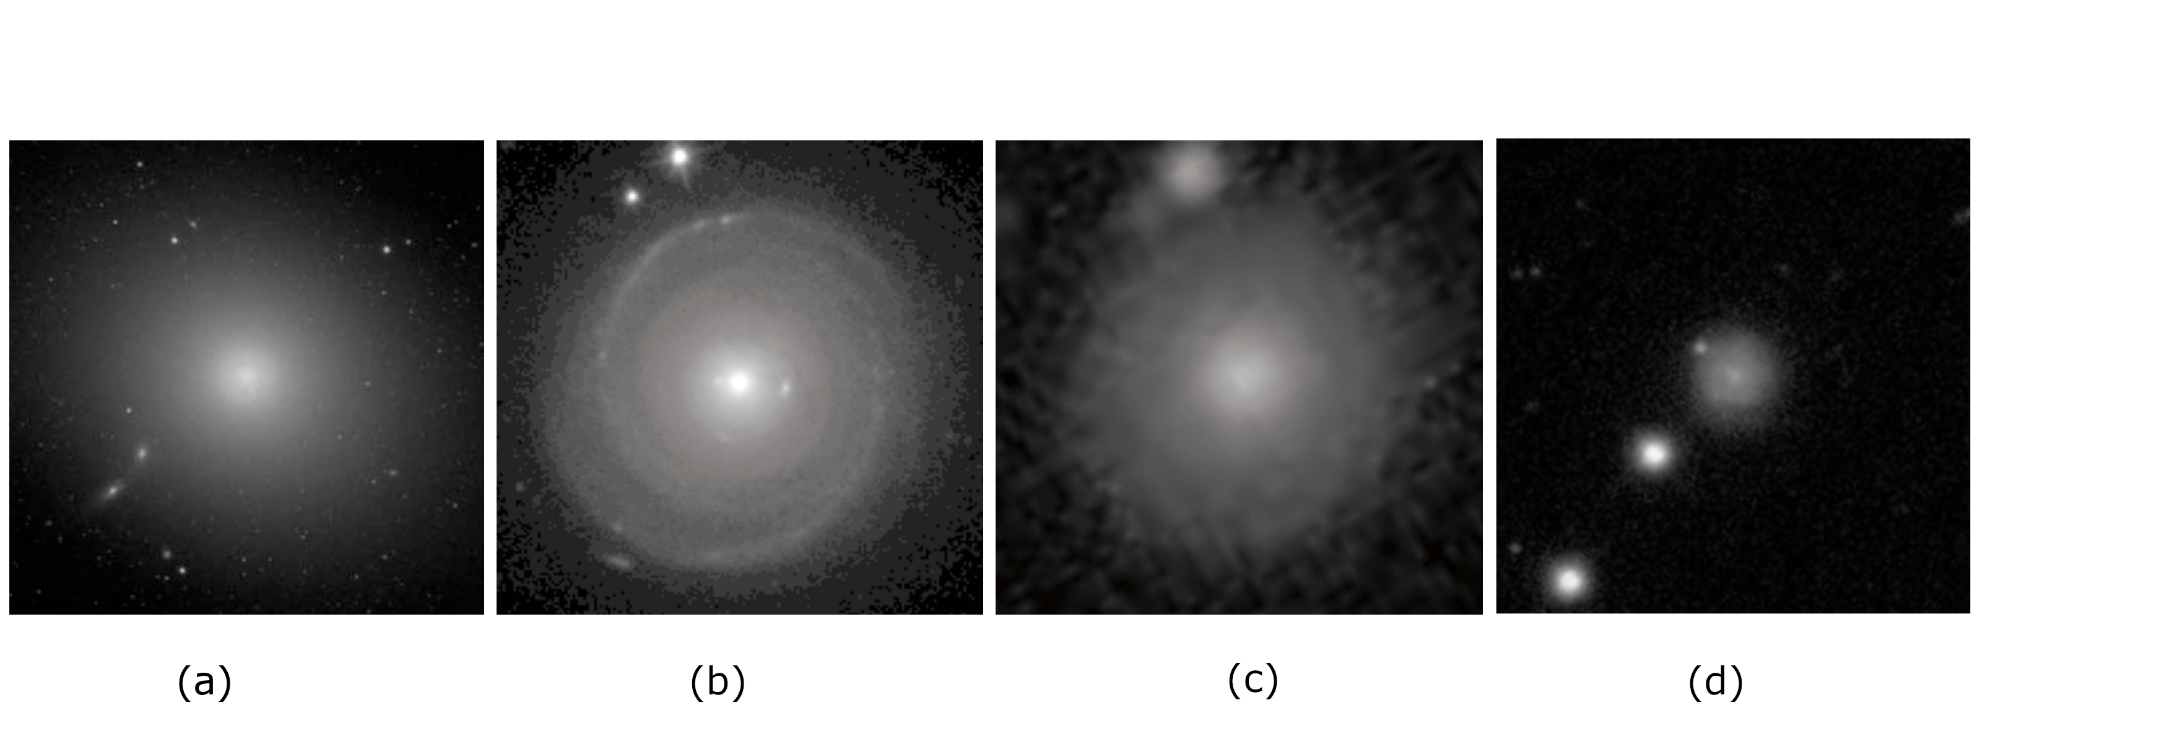
MOTIVATION
GOLD STANDARD BIAS
Elliptical:
Featureless
Disk:
Spiral
Elliptical:
Featureless
Elliptical:
Featureless

Slide 5
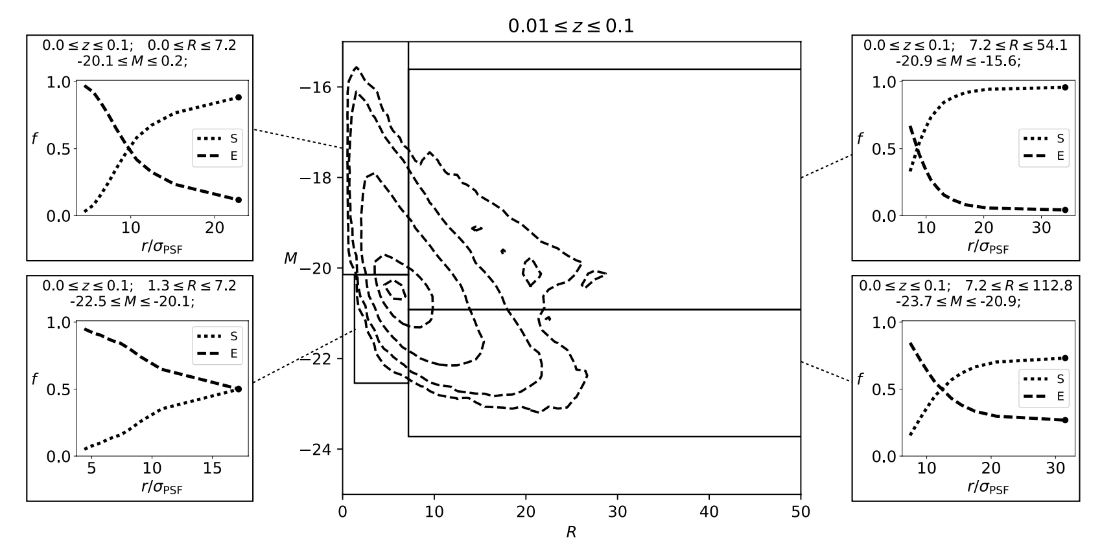
INTRINSIC vs OBSERVED DISRTRIBUTION
NEARBY
DISTRIBUTION
FRACTON
DISTRIBUTION
FRACTON
<- INCREASING REAL BRIGHTNESS
DISTRIBUTION
FRACTON
DISTRIBUTION
FRACTON
INCREASING REAL SIZE ->
IMAGE RESOLUTION
IMAGE RESOLUTION

Slide 6
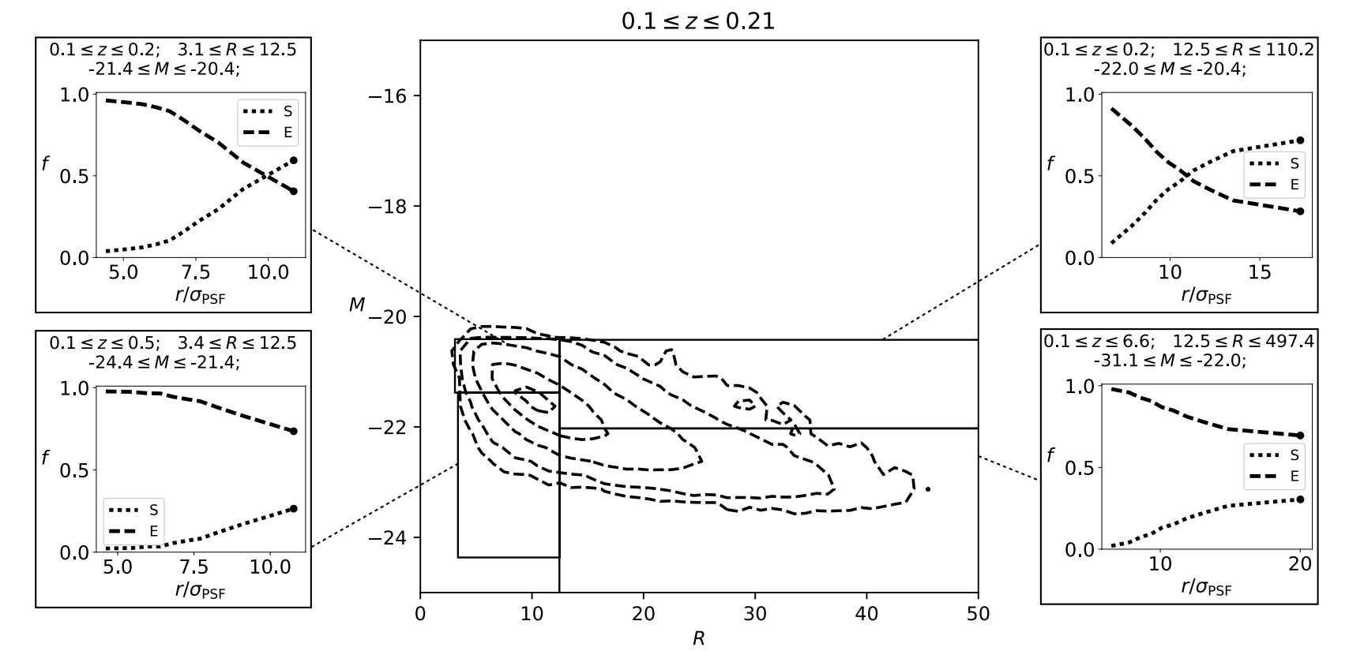
INTRINSIC vs OBSERVED DISRTRIBUTION
DISTANT
DISTRIBUTION
FRACTON
DISTRIBUTION
FRACTON
<- INCREASING REAL BRIGHTNESS
DISTRIBUTION
FRACTON
DISTRIBUTION
FRACTON
INCREASING REAL SIZE ->
IMAGE RESOLUTION
IMAGE RESOLUTION

Slide 7
INTRINSIC vs OBSERVED DISRTRIBUTION
NEARBY
DISTRIBUTION
FRACTON
DISTRIBUTION
FRACTON
DISTRIBUTION
FRACTON
<- INCREASING REAL BRIGHTNESS
DISTRIBUTION
FRACTON
DISTRIBUTION
FRACTON
INCREASING REAL SIZE ->
IMAGE RESOLUTION
IMAGE RESOLUTION

Slide 8
INTRINSIC vs OBSERVED DISRTRIBUTION
DISTANT
DISTRIBUTION
FRACTON
DISTRIBUTION
FRACTON
<- INCREASING REAL BRIGHTNESS
DISTRIBUTION
FRACTON
DISTRIBUTION
FRACTON
INCREASING REAL SIZE ->
IMAGE RESOLUTION
IMAGE RESOLUTION

Slide 9
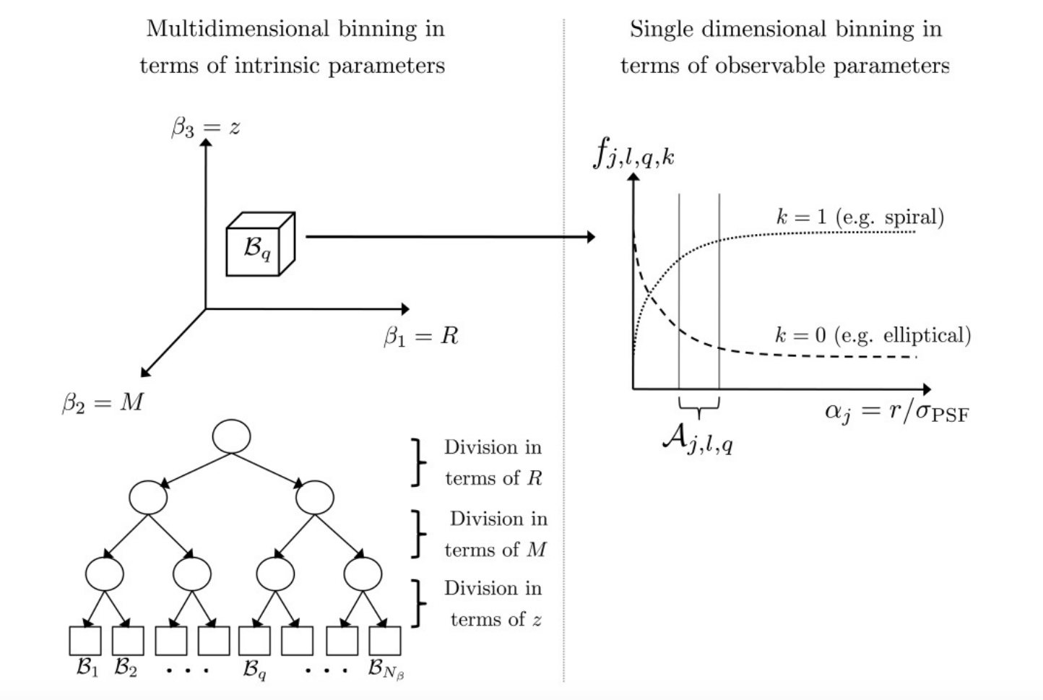
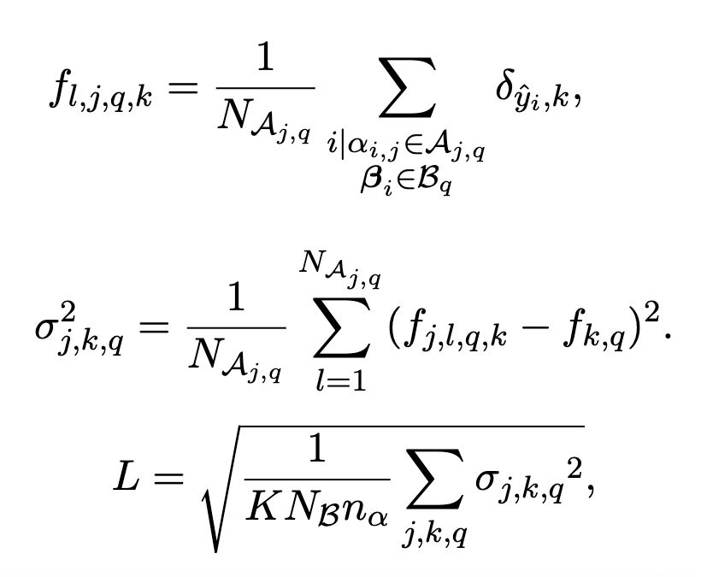
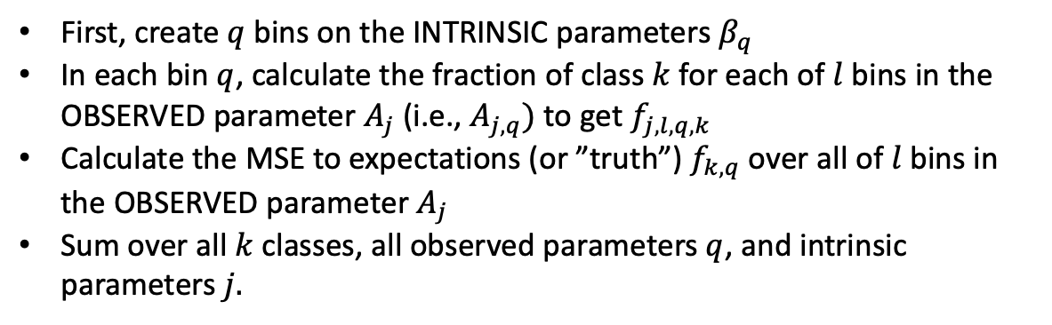
First, create $q$bins on the INTRINSIC parameters $β_{q}$
In each bin $q$, calculate the fraction of class $k$ for each of $l$bins in the OBSERVED parameter $A_{j}$ (i.e., $A_{j,q})$ to get $f_{j,l,q,k}$
Calculate the MSE to expectations (or ”truth”) $f_{k,q}$ over all of $l$bins in the OBSERVED parameter $A_{j}$
Sum over all $k$ classes, all observed parameters $q$, and intrinsic parameters $j.$

Slide 10
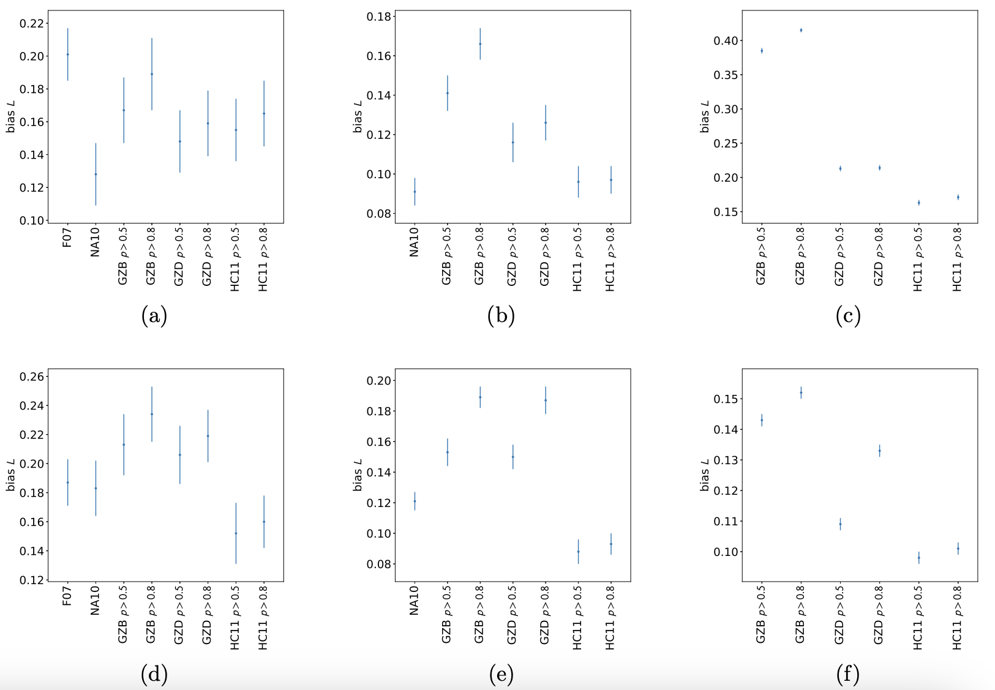
Distance as the observable bias
Experts can be biased.
Expert 1
Expert 2
Confident labels can be biased
low
high
Resolution as the observable bias
Machine Learning can debias
SVM trained
On Expert 1

Slide 11
New Issues with Supervised Learning
Gold standard labels can be biased
Whether trust is earned, verification is required
Experts have ”know how”, which is not immune from hidden bias.
Citizen scientists have “know what” which have different bias.
Labels with high confidence can amplify underlying bias
Labeling error is not the issue
Better data can be expensive
SVMs mitigate bias present in the gold standard truth labels
Example shown used galaxy properties, not the images.
The machine was able to combine those properties in a non-linear way
Let the machines work directly on the pixels

Slide 12
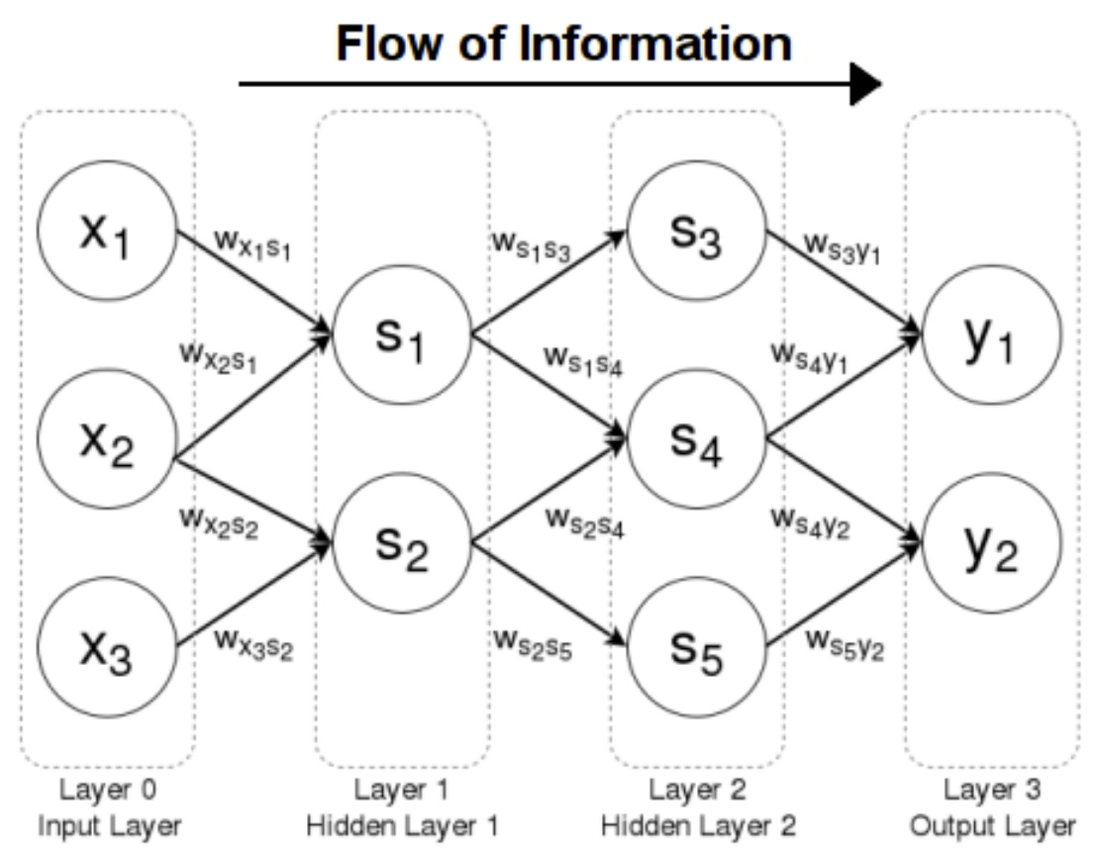
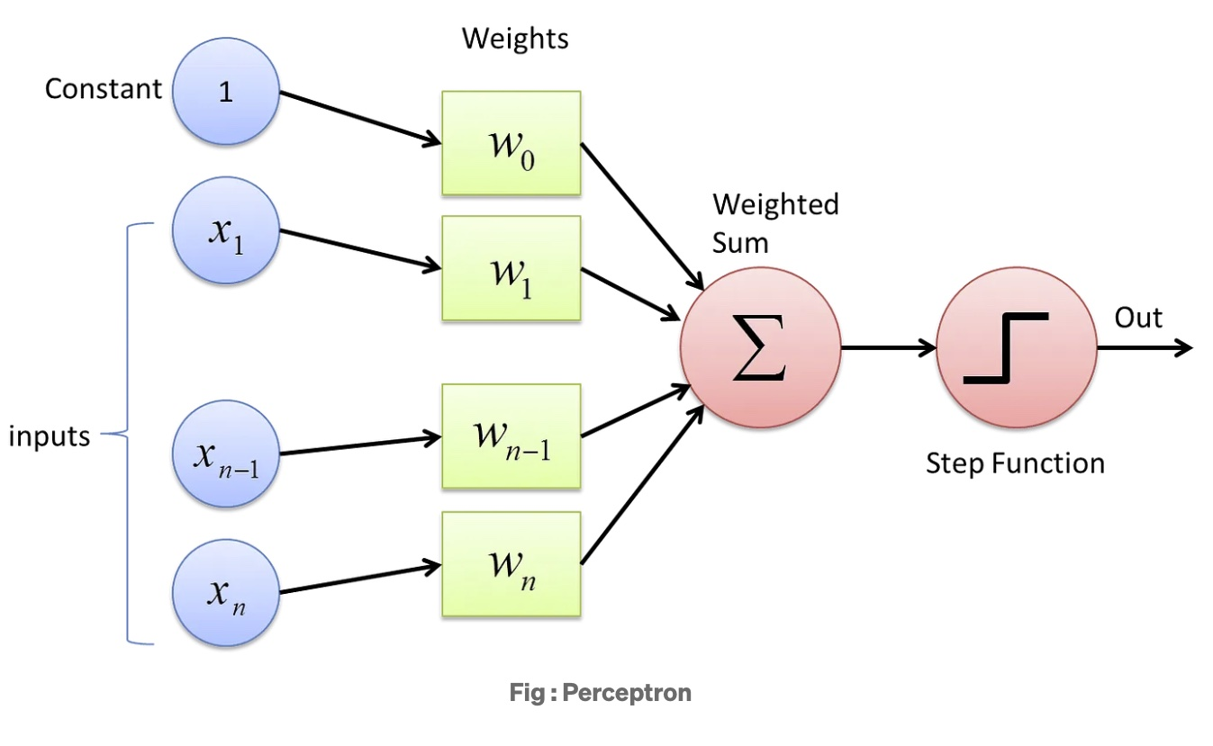
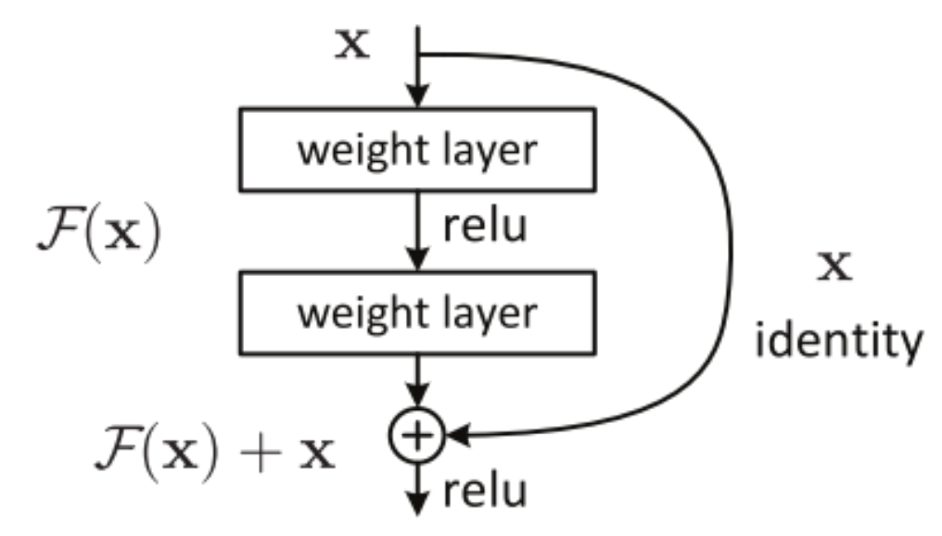
The AI System: Residual Convolutional Neural Networks

Slide 13
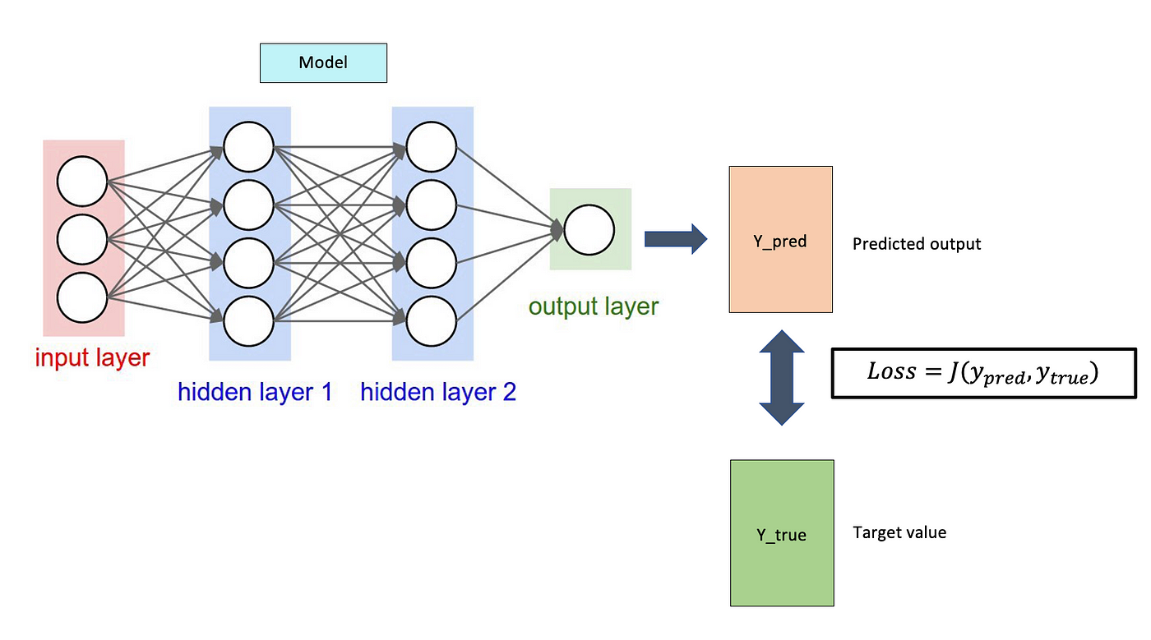
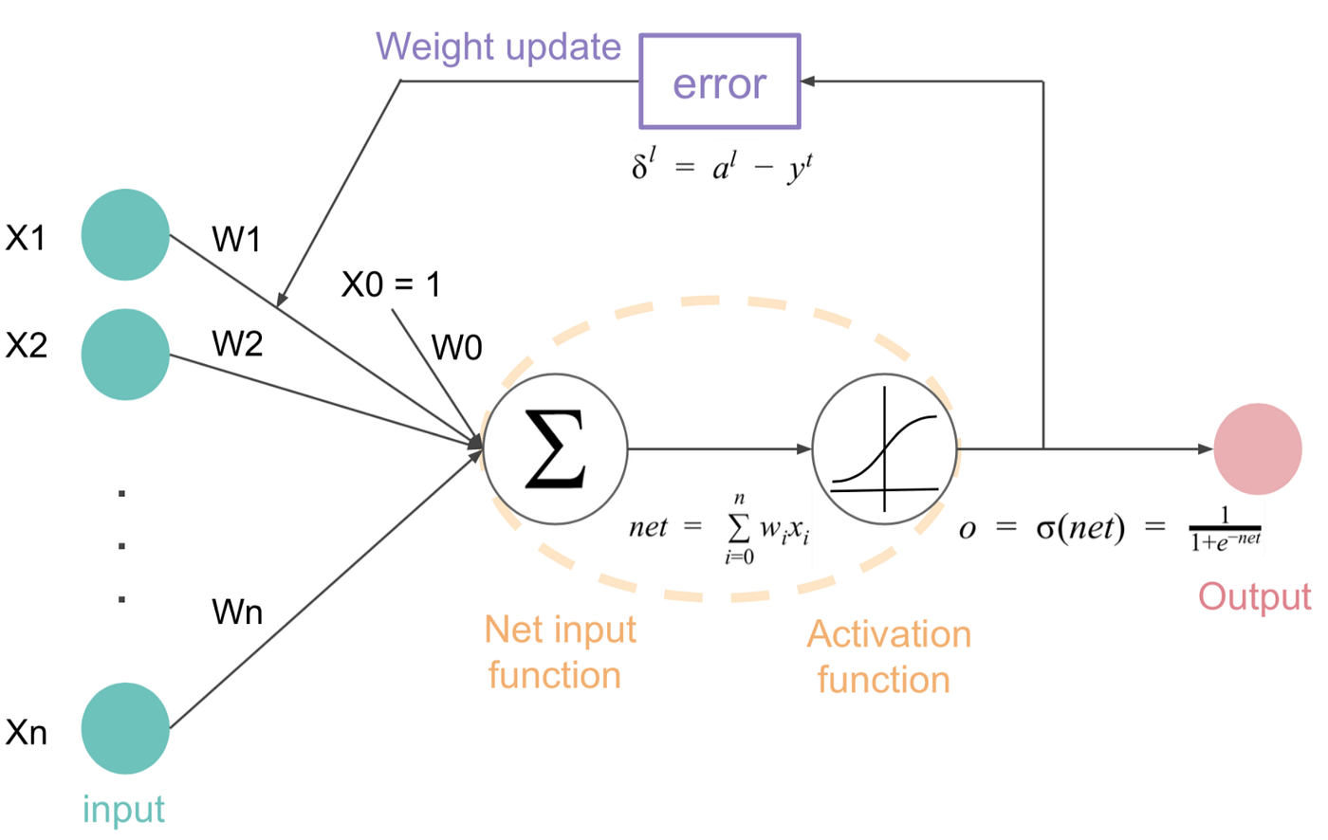
Debiasing in an AI System: Convolutional Neural Networks
The CNN learns the weights and the convolution filters through training.
The LOSS Function plays a critical role.

Slide 14
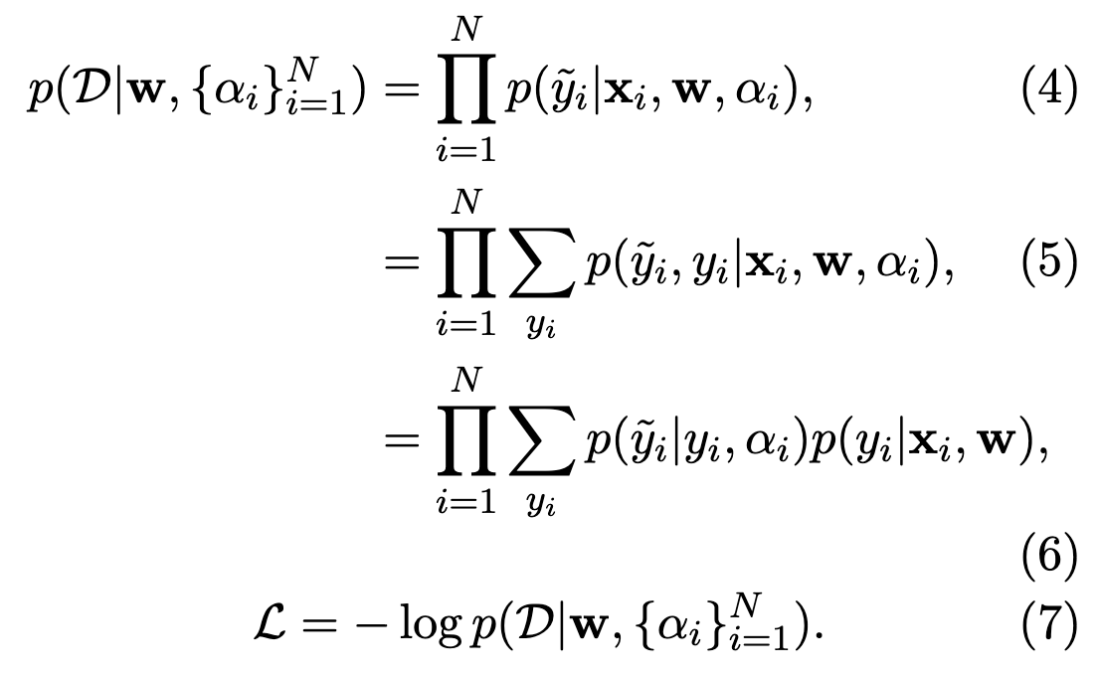
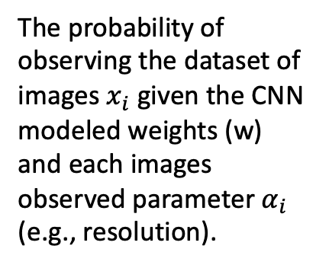
Revising the CNN Loss Function
The probability of observing the dataset of images $x_{i}$ given the CNN modeled weights (w) and each images observed parameter $α_{i}$ (e.g., resolution).
There is a known prior probability for the true class given the data and the fitted parameters (in this case, the weights from the CNN model).
The likelihood of the observed class depends only on the true class and the observed (biasing) parameters.
The log likelihood contributes to the total loss likelihood function in the CNN training

Slide 15
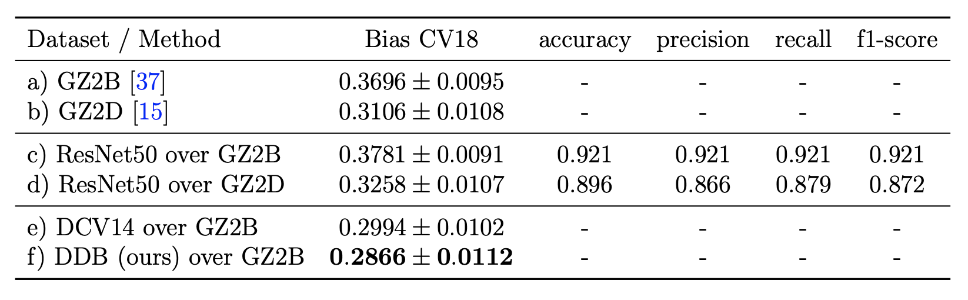
AI system De-biasing
The ResNet50 CNN AI system (i.e., using just the pixels) recovers the human eye-brain systems
Catalog-level machine learning (DVC14 logistic regression/SVM) de-biases the classifications
Pixel-level de-biasing (ResNet50 with revised loss function) performs the best

Slide 16
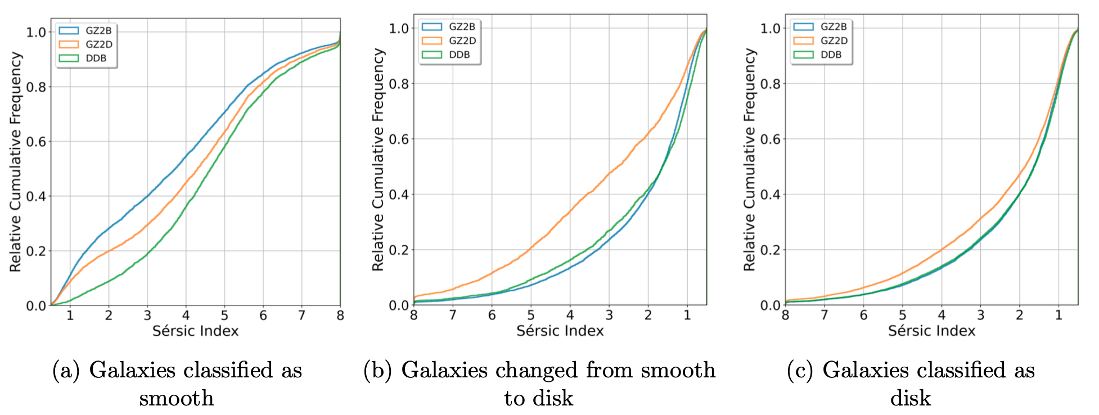
Is the CNN model trustworthy?
The Sersic index is the power-law of the radial light profile
Ellipticals are >3
Spirals are < 3

Slide 17
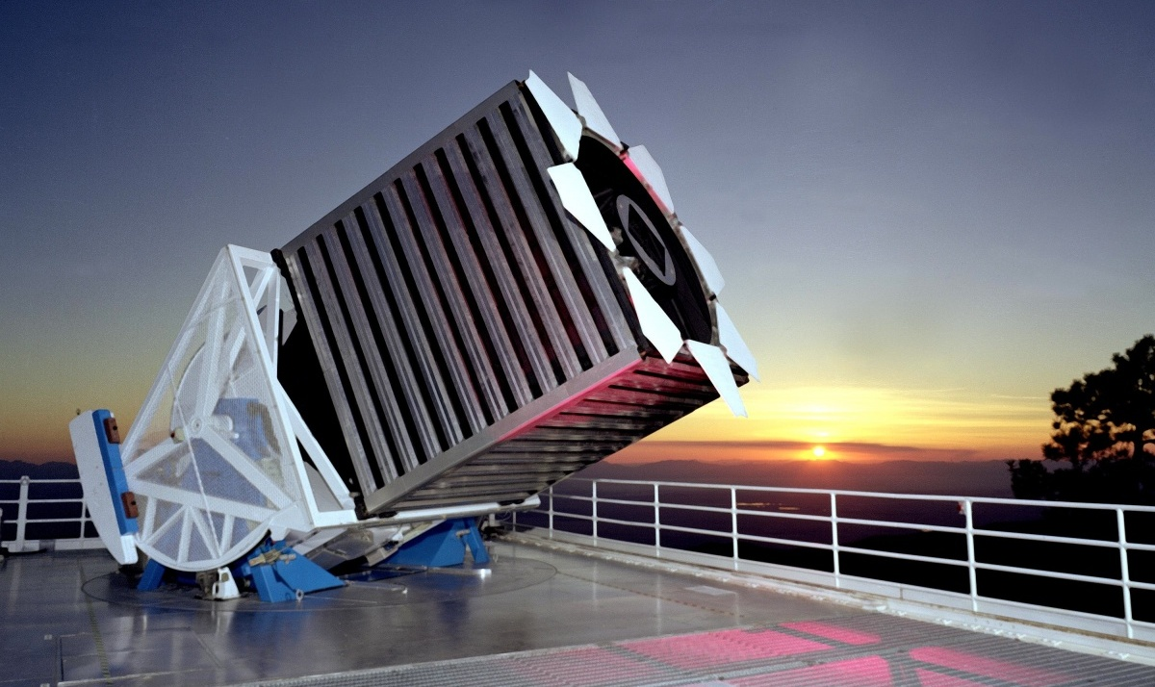
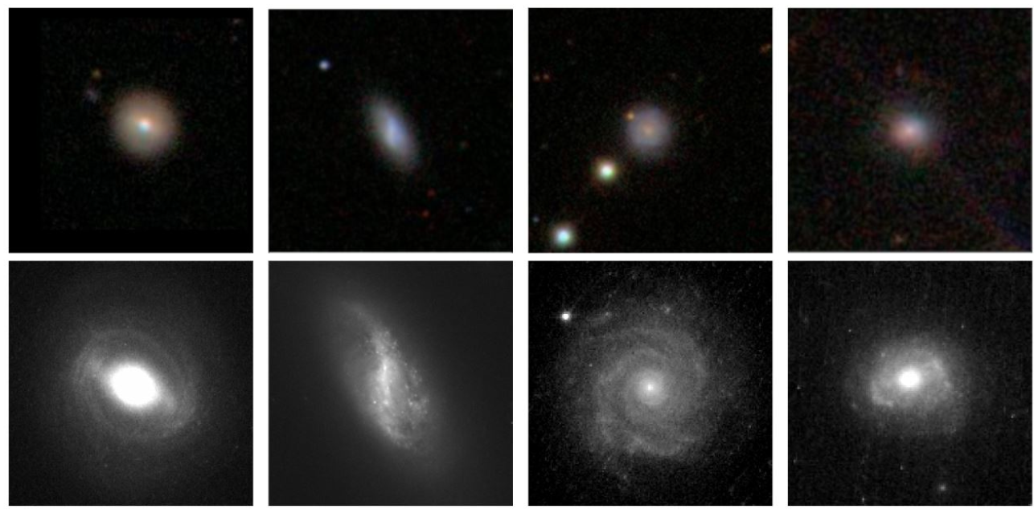
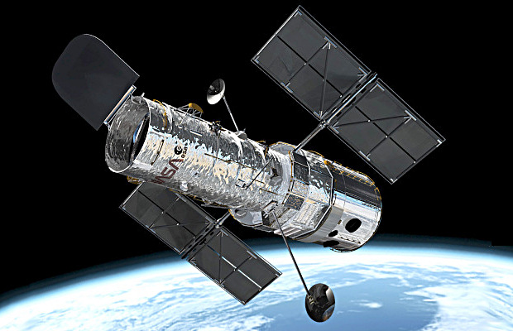
Is the model trustworthy?

Slide 18
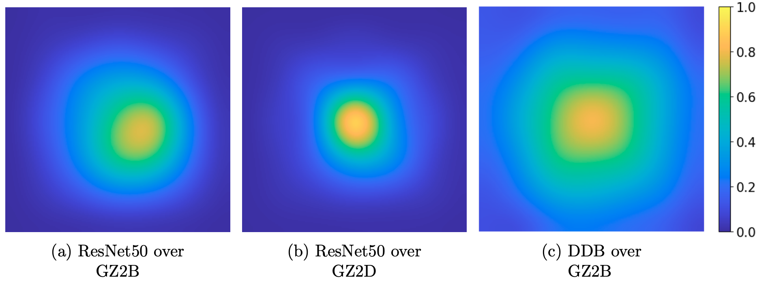
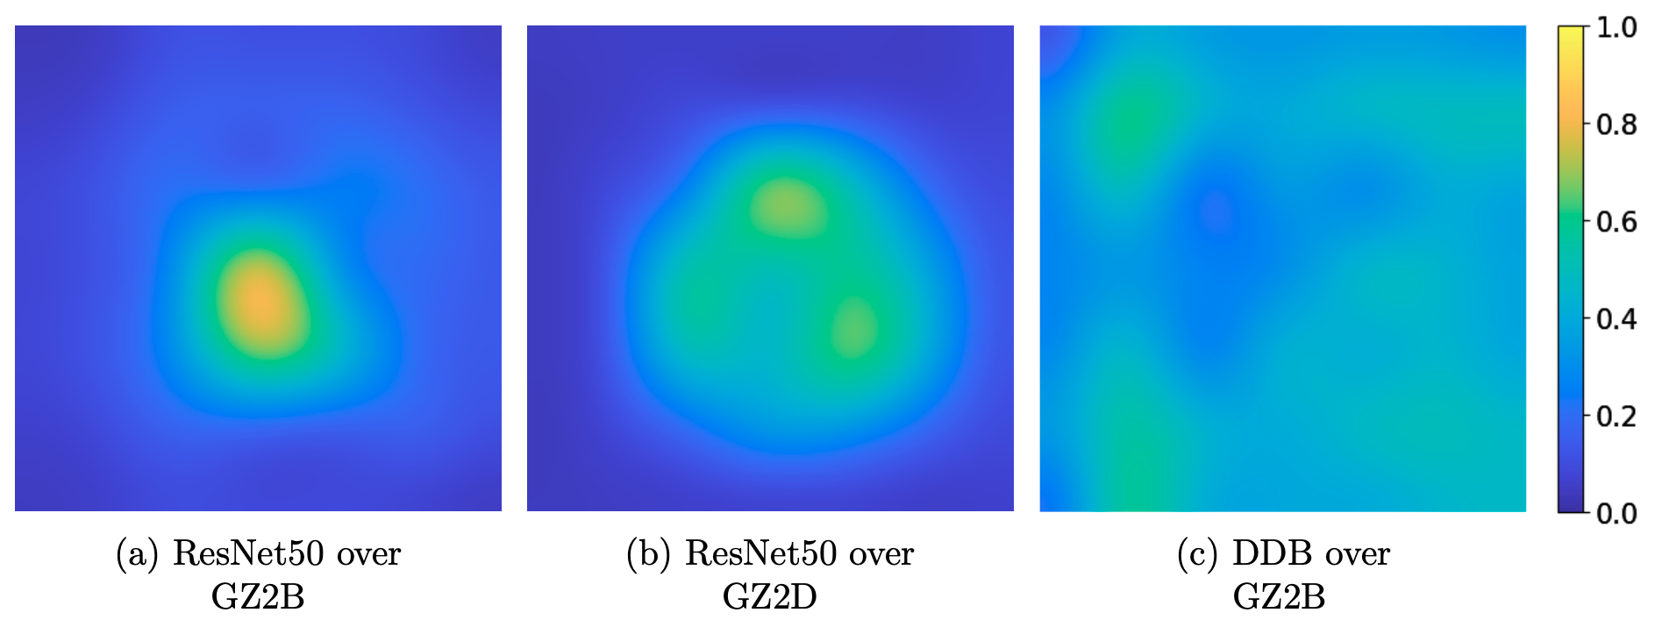
Can we interpret the CNN model?
For spiral galaxies, the CNN is paying attention to more of the galaxy light when the de-biasing likelihood is included in the loss function. The core matters more than the outskirts.
For elliptical galaxies, the model with de-biasing in the loss spends time nearly equally on every pixel. The machine needs to be convinced that the whole morphology really is featureless.

Slide 19
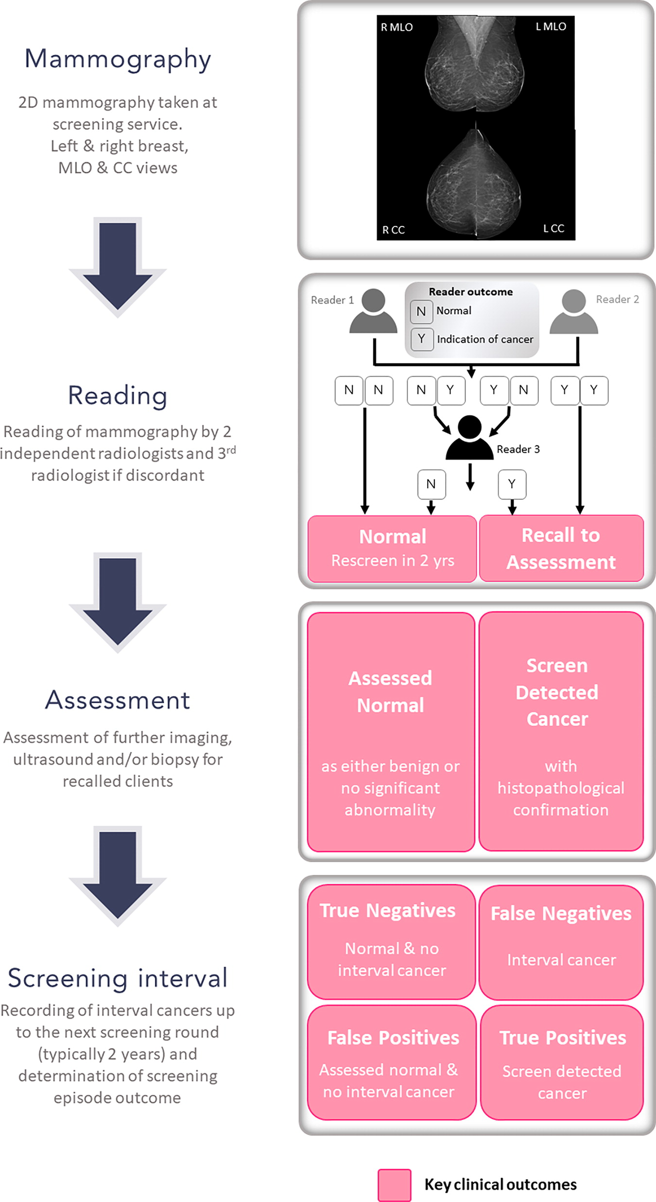
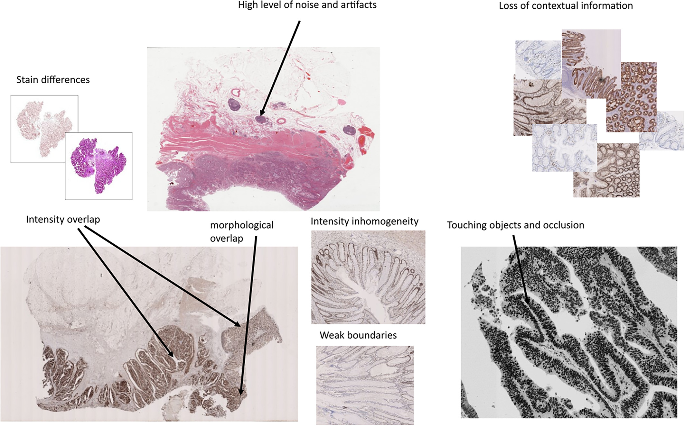
An AI System De-biasing Framework for Remote Sensing
Remote sensing is the acquisition of information about an object or phenomenon without making physical contact with the object.
Consider radiology and follow-up histopathology image analysis (whole slide images pr WSI)

Slide 20
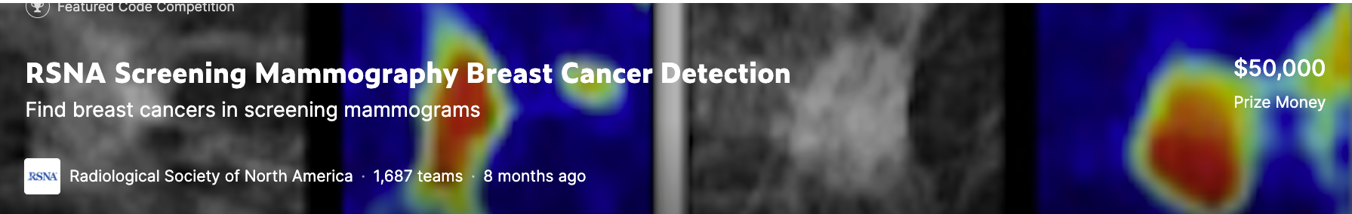
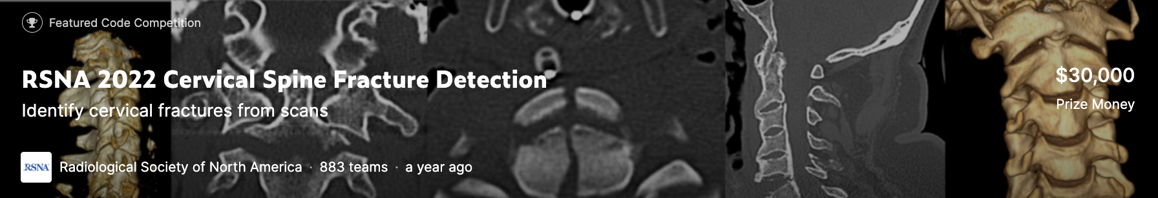
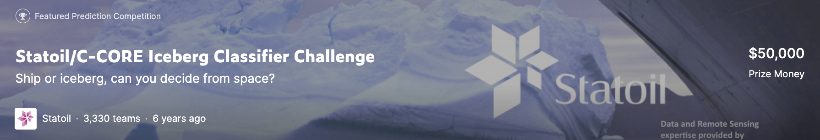
An AI System De-biasing Framework for Remote Sensing

Slide 21
Research Vision
Recognition of gold standard labeling bias as critical to advancing AI
Network with researchers from different domains
Build-out intrinsic and observed parameters for classifications over wider domains
Scope the problem
Related works:
“Disentangling Human Error from the Ground Truth in Segmentation of Medical Images” Le Zhang, Ryutaro Tanno, et al. Neural Information Processing… 31, July 2020
“Measuring Model Biases in the Absence of Ground Truth”, Aka, Burke, et al. AIES ’21, May 19–21, 2021
"Is AI ground truth really true? The dangers of training and evaluation AI tools based on experts' know-what." Lebovitz, S., Levina, N., Lifshitz-Assaf, H. (2021). Management Information Systems Quarterly, 45(3b), pp: 1501-1525
Deploy the machinery to identify, quantify, and mitigate labeling bias
Move beyond ROC/AUC when ranking AI systems
Connect and collaborate with domains which share this issue
Re-evaluate the results of AI systems and models after bias mitigation

